Slide 1


Slide 2
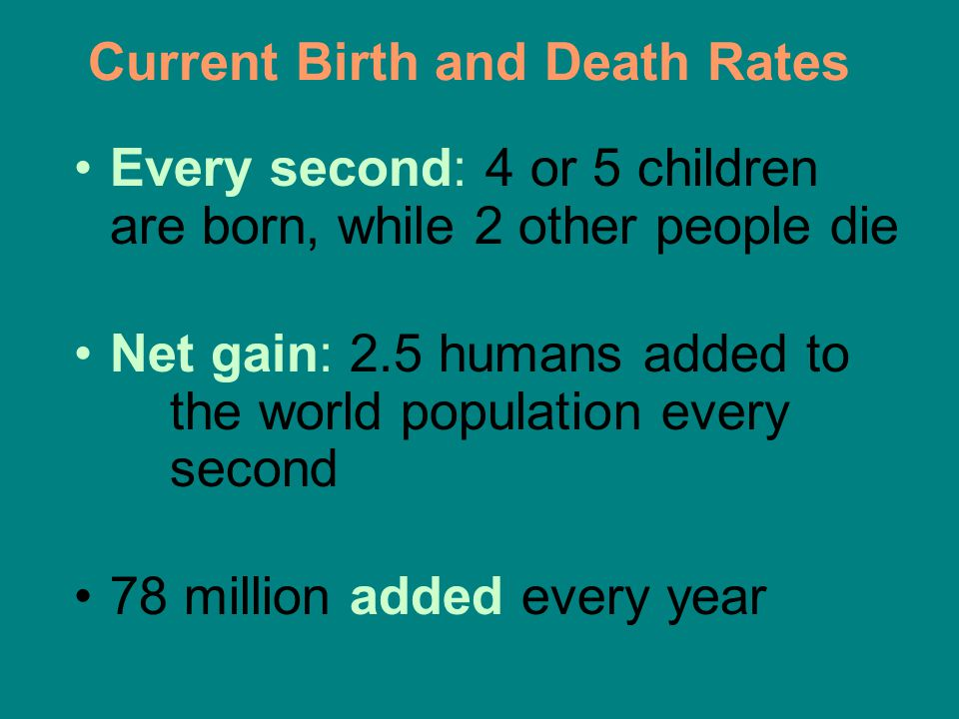
Notes:
Current estimate of world growth rate is 1.2 % annually

Slide 3
400,000
4.86 Billion
7.48 Billion
Notes:
Over 400,000 people will be added to the population during the 2 days of this conference
In 1985 there were 4.86 billion in the world
In 2017 there are 7.48 billion
Almost 3 billion in my working career

Slide 4

Notes:
Artwork of Chris Jordan – very informative TED talk

Slide 5

Notes:
One million plastic cups used on airlines every 6 hours -

Slide 6
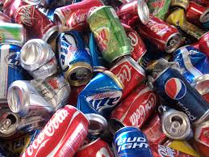
Notes:
100,000 aluminum cans every 30 seconds

Slide 7

Notes:
Exponential growth

Slide 8
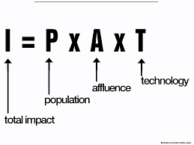

Slide 9
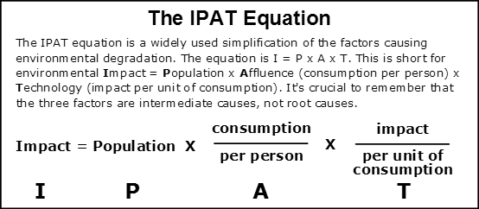

Slide 10


Slide 11
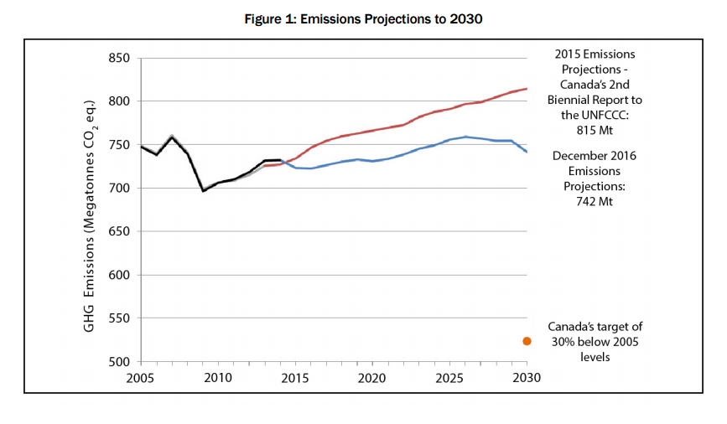

Slide 12
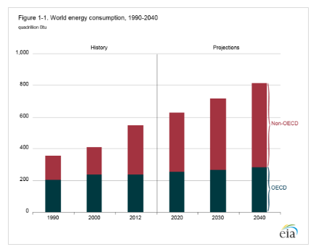
Notes:
From the U S Energy Information Administration – May 11, 2016 release on International Energy Outlook

Slide 13
Small Solutions
The question “what can we do?” especially when the problem is large, implies the expectation of a large solution.
But perhaps big problems require small solutions

Slide 14


Slide 15
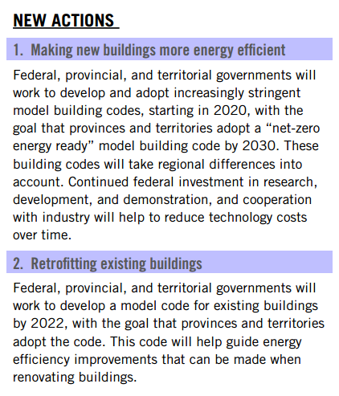

Slide 16
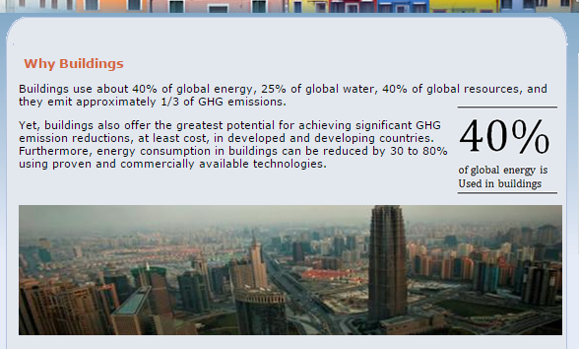

Slide 17
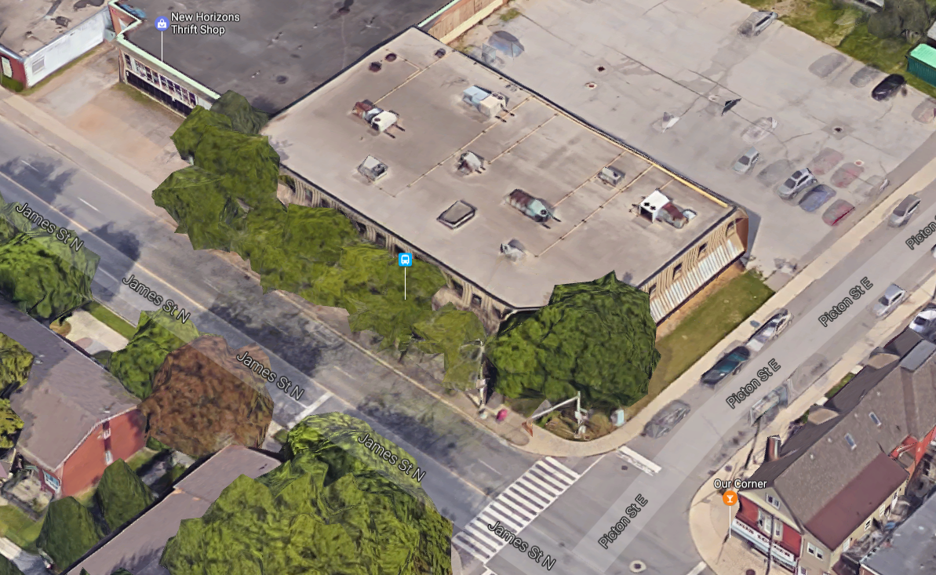

Slide 18
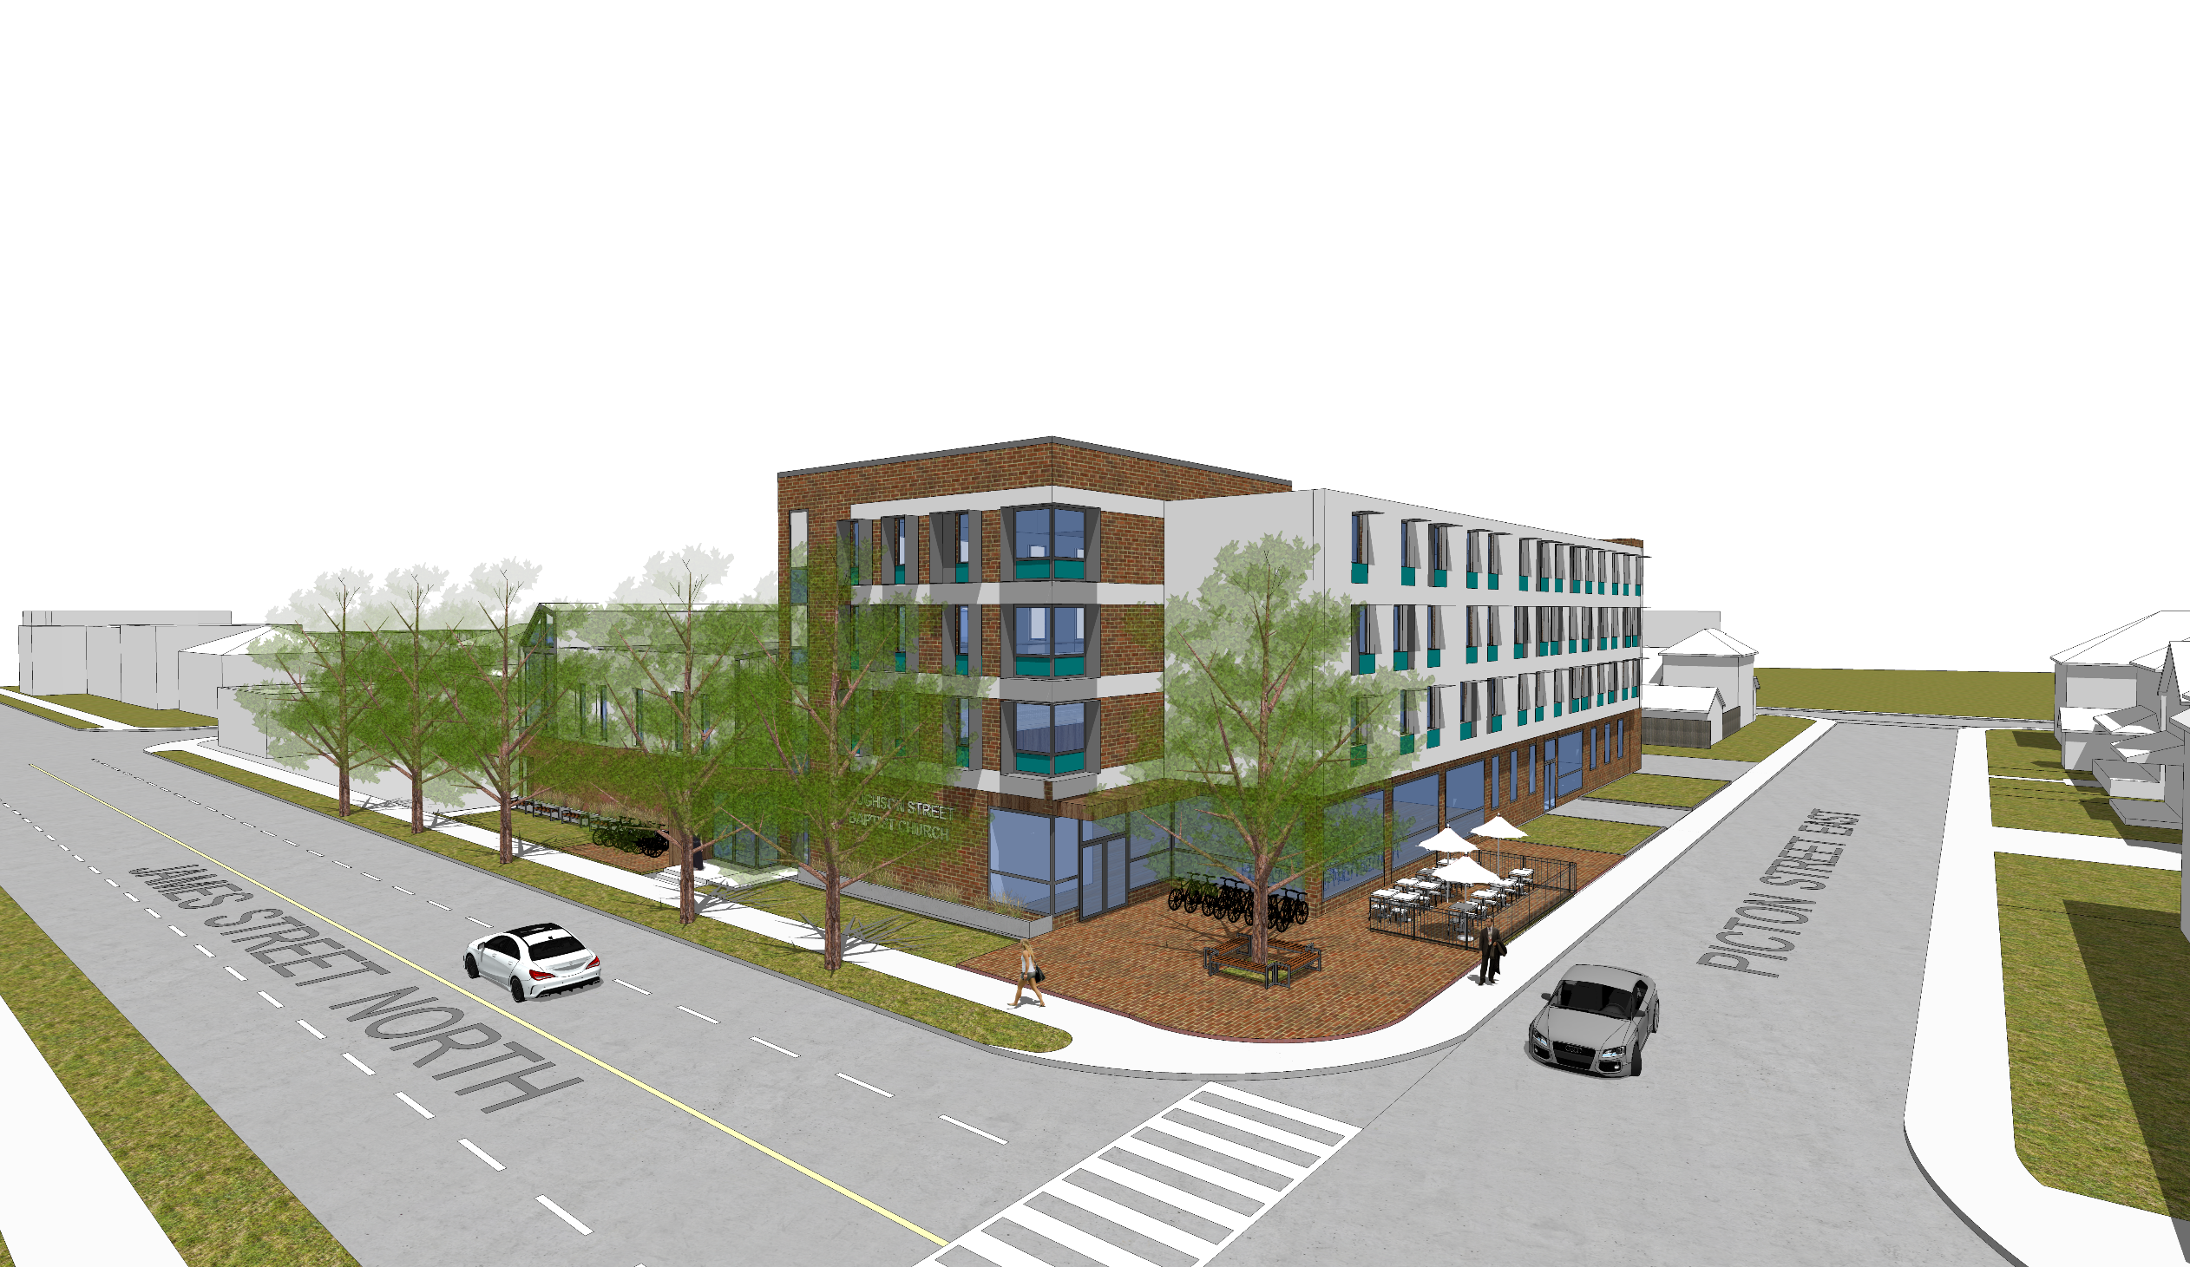

Slide 19
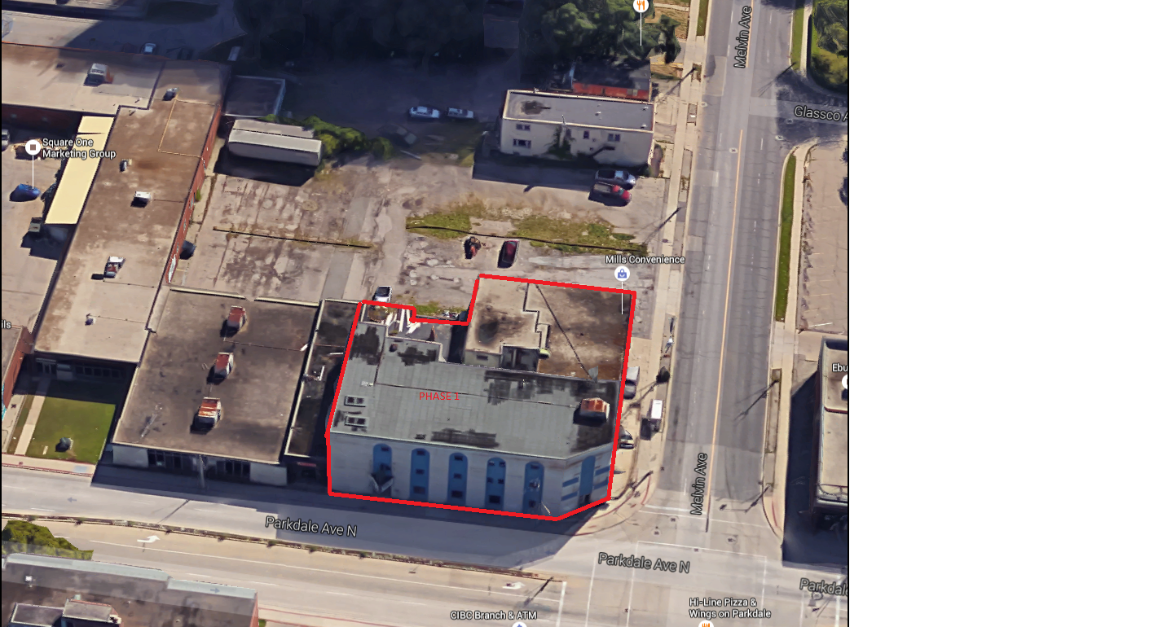

Slide 20
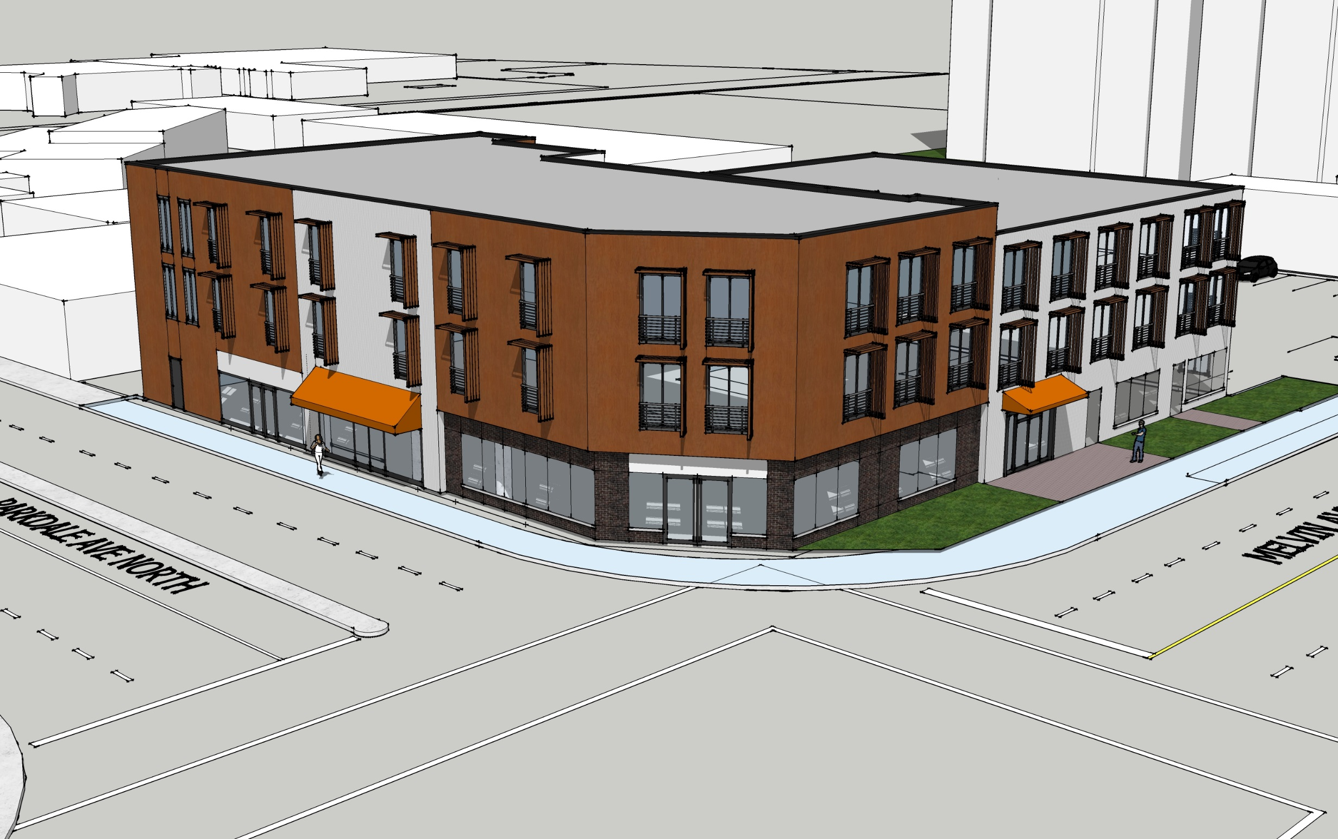

Slide 21
Energy density (per m²) for Canadian residential buildings
kWh/m²/yr
space heating: 146
water heating: 38
appliances: 31
lighting: 9
space cooling: 2
source: NRCan Energy Use Data Handbook 2010 and Energy Efficiency Trends in Canada 1990-2009, retrieved Nov 2013
author + graphic: Wim

Slide 22
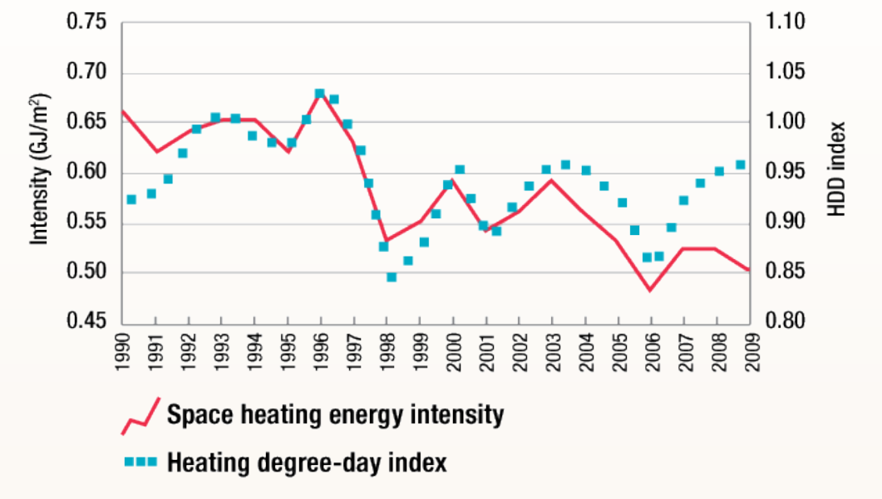
PH vs OBC
0.40
0.35
90% reduction compared to 2009
0.30
0.25
0.20
Passive House space heating demand
0.15
0.10
0.05
0.00

Slide 23
Essential Features

Slide 24
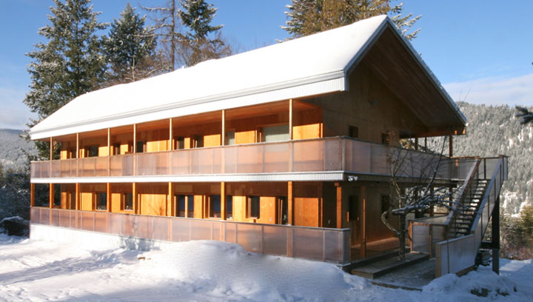
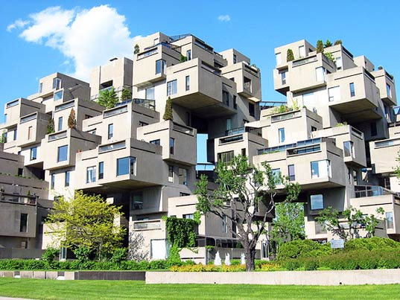
Compact Design

Slide 25
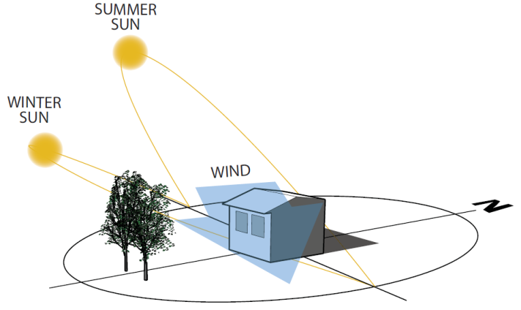
Effective Solar Access
Graphic: Lighthouse Sustainable Center Source: Passive Design Tool Kit CoV Author: Wim

Slide 26
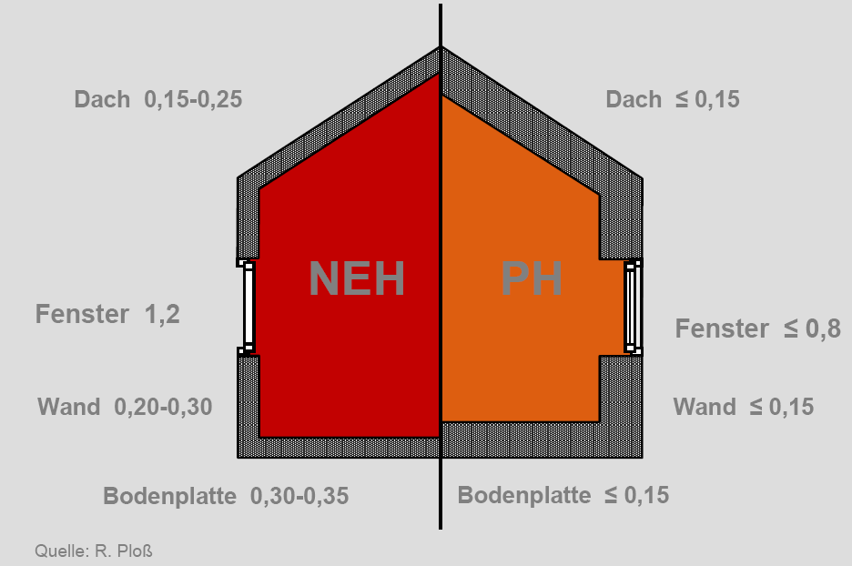
Super-Insulated
These are only a starting point for PH!
- May be more or less demanding
Typical U-values (W/m²K ) - Residential (Part 9)
Nominal vs Effective
ROOF: 0.11-0.19
(R30 - 52)
ROOF ≤ 0.11
(R50)
OBC
PH
WINDOW:
1.6-2.0
IP: 0.28 – 0.35
WINDOW ≤ 0.8
IP: 0.14
WALL: 0.18-0.42
(R14 – 32)
WALL ≤ 0.11
(R50)
FLOOR SLAB: 0.21-0.57
(R10 – 27)
FLOOR SLAB ≤ 0.11
(R50)

Slide 27
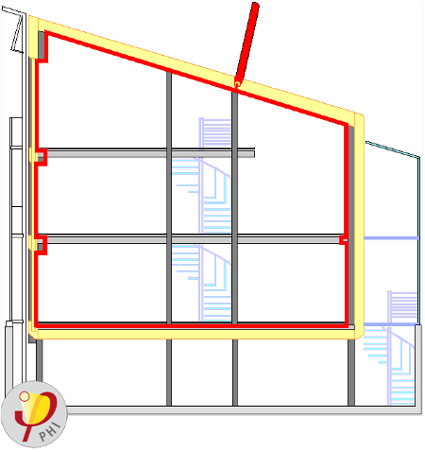
Airtight Envelope
Passive House
≤ 0.6 ach@50Pa
Typical New Build:
3-5 ach@50Pa
The Magic Red Pen
Image Source: PHI
Notes:
Airtight layer can be internal and external

Slide 28
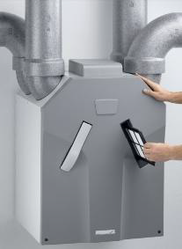
Heat Recovery Ventilation
Whole House Ventilation
Balanced exhaust and supply
Efficient Recovery
Filtering
High Level of Comfort
Frost protection
Image Source: Zehnder
Notes:
Subsoil heat exchanger is not necessary in most UK applications.
1995: concept
1997: prototype
2005: 8 systems available on the market
1995: concept
1997: prototype
2005: 8 systems available on the market

Slide 29


Slide 30

Notes:
Shift from Big to Small
Net Zero Communities
Need to reduce consumption while we develop new renewable energy sources

Slide 31


Slide 32

Notes:
The four circles

Slide 33


